Slide 1
Computer network
Un-guided media

Slide 2
Un-guided Media
Computers and other telecommunication devices use signals to represent data. These signals are transmitted from one device to another in form of electromagnetic energy wave, which is propagated through transmission media/medium.
Unguided media transport electromagnetic waves without using a physical conductor.
This type of communication is often referred to as a Wireless Communication.

Slide 3
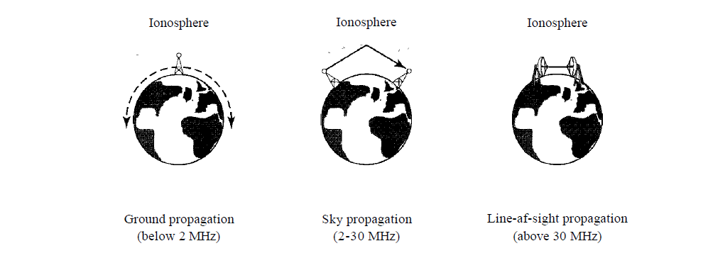
Types of un-guided media
Unguided signals can travel from source to destination in several ways:
Ground propagation
Sky propagation
Line-of-sight propagation

Slide 4
Types of un-guided media
In ground propagation, radio waves travel through the lowest portion of the atmosphere, hugging the earth/data.
In sky propagation, higher-frequency radio waves radiate upward into the ionosphere where they are reflected back to the earth.
In line-of-sight propagation, very high-frequency signals are transmitted in straight lines directly from antenna to antenna.

Slide 5
Wave types
Wireless
Transmission
Radio
Wave
Microwave
Infrared
Wireless transmission divided into three groups:
1. Radio waves
2. Micro waves
3. Infrared

Slide 6
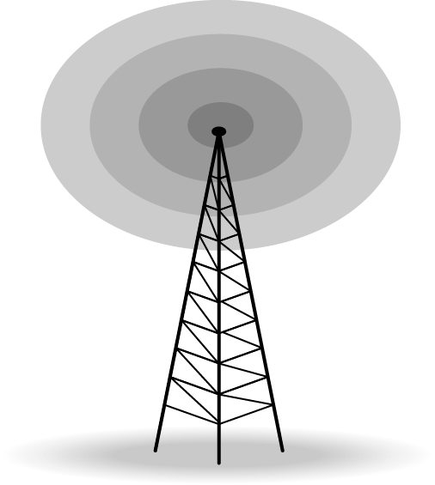
Radio waves
Radio waves are used for multicast communications, such as radio and television.
They can penetrate through walls.
Highly regulated. Use Omni directional antennas
Frequencies between 3 kHz and 1Ghz

Slide 7
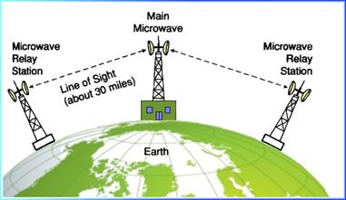
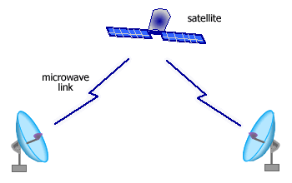
Micro waves
Microwaves are used for unicast communication such as cellular telephones, satellite networks, and wireless LANs.
Higher frequency ranges cannot penetrate walls.
Use directional antennas - point to point line of sight communications.
1 and 300 GHz

Slide 8
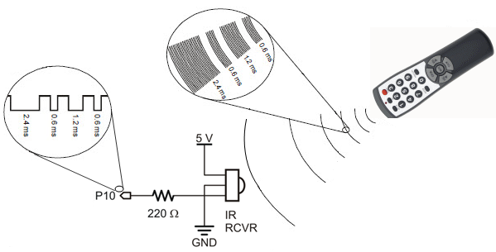
infrared
Infrared signals can be used for short- range communication in a closed area.
using line-of-sight propagation
300 GHz to 400 THz

